Slide 1

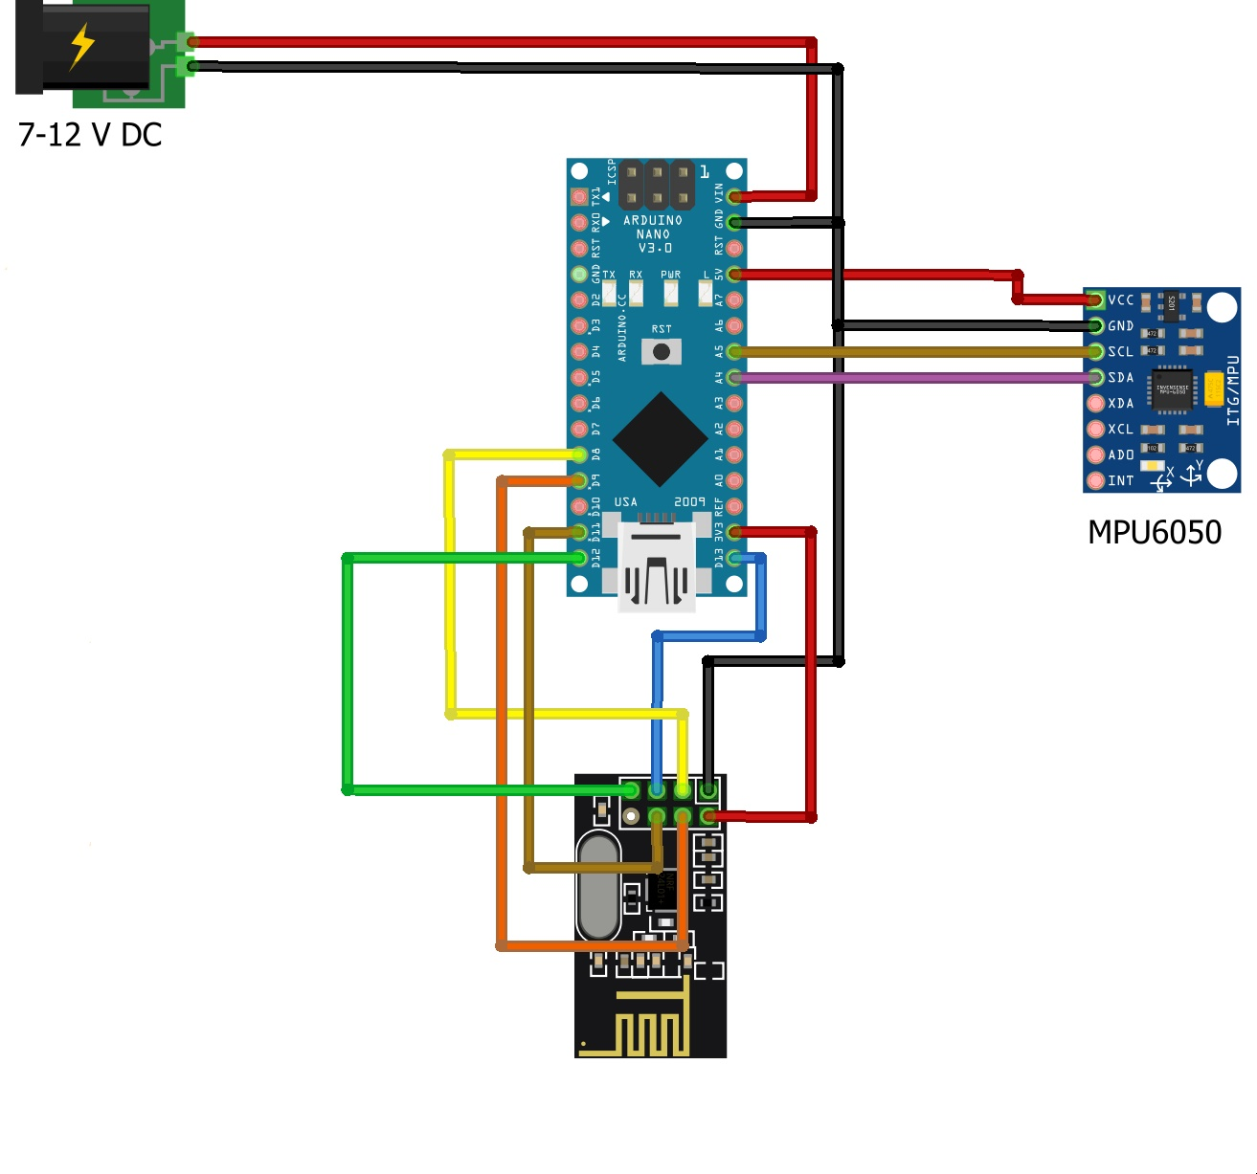
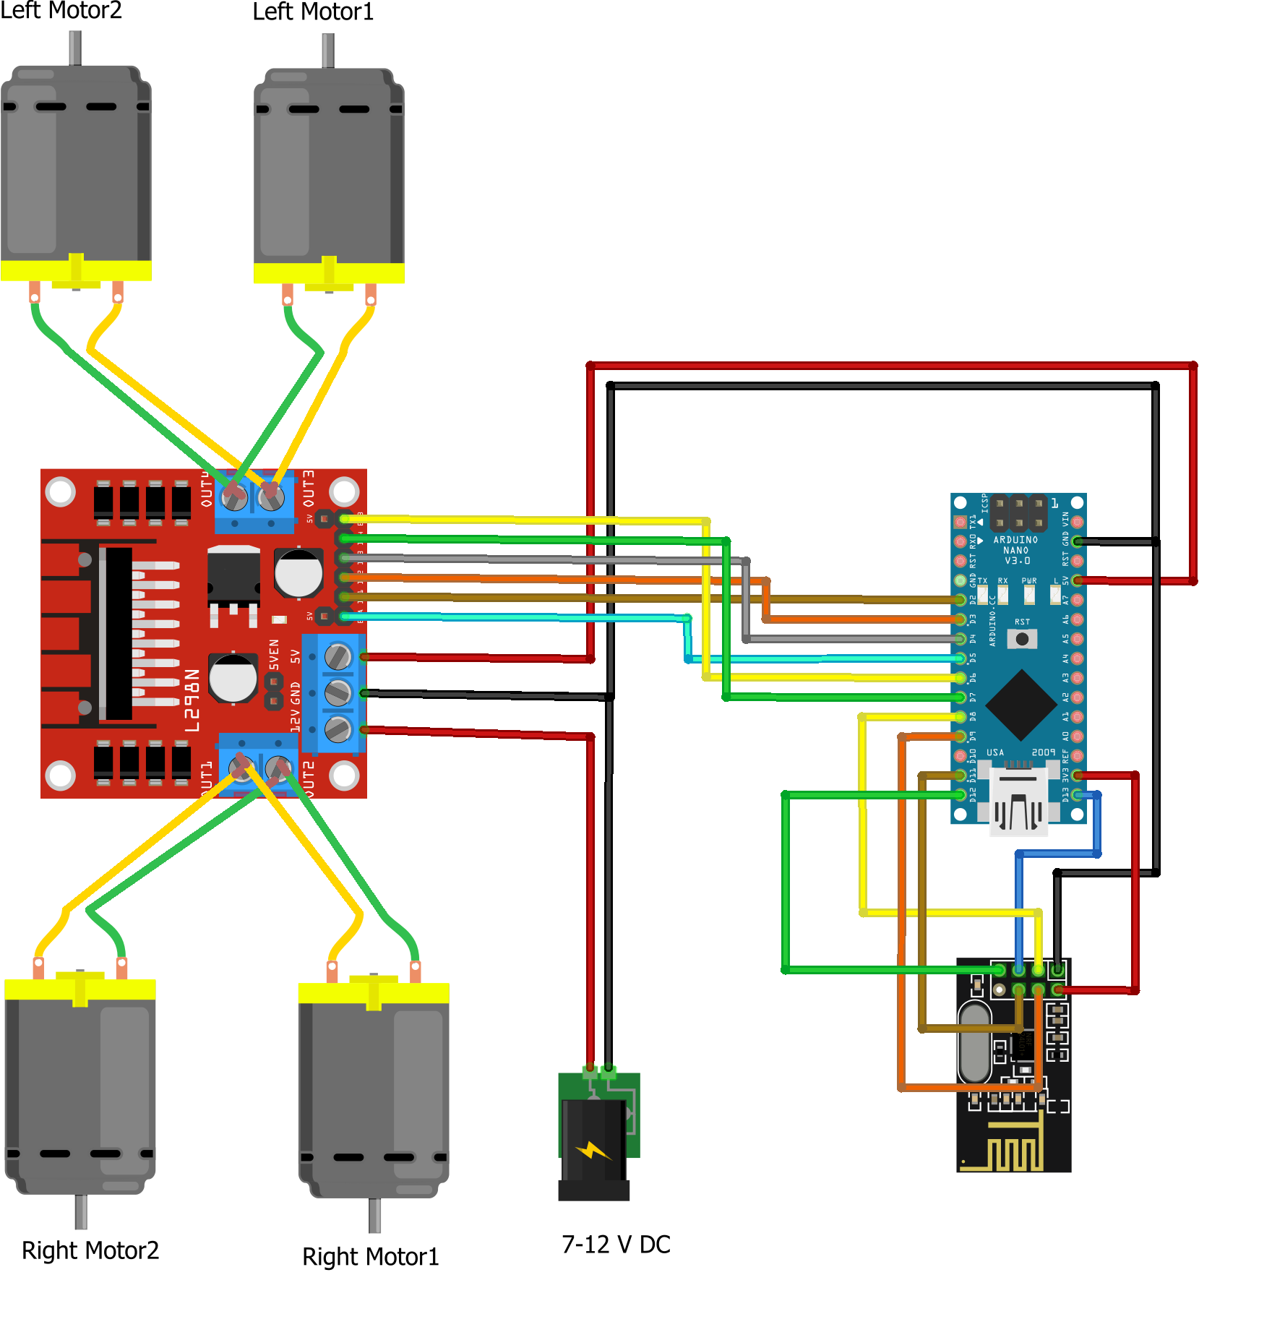
Arduino Based Hand Gesture Control Car
Supervised by-
Dr. Md. Faruque Hossain
Department of Electronics And Communication Engineering
Course No : ECE-3200
Represented By -
1809042,1809044
Objective
.
.
Introduction
to present the control of the robot utilizing the accelerometer with the assistance of human hand gesture. Where the accelerometer data is received with the help of hand gesture and assisted wirelessly.
Gesture recognition is a topic in science and language technology with the goal of interpreting human gestures via mathematical algorithms. Gestures can originate from any bodily motion or state but commonly originate from the face or hand. Users can use simple gestures to control or interact with devices without physically touching them. Gesture recognition can be seen as a way for computers to begin to understand human body language. Using the concept of gesturerecognition, it is possible to point a finger at this point will move accordingly. This could make conventional input on devices such and even redundant.
.
.
.
Required Apparatus
Arduino Nano
Nrf24l01
MPU6050 module
7-12 V DC battery
Double sided tape
4WD car kit
L298N driver module
Breadboard
Jumper wires
Fig 1- Block Diagram of the prototype
Application
Working Principle
Remote Surveillance military applications, Bomb Diffusion Robots
It can be used by Physically challenged in wheelchairs
It can control industrial grade robotic arms can be developed.
It can also be used on construction Fields and civil works
An RF transmitter module is a small PCB ie, printed circuit board sub-assembly capable of transmitting a radio wave and modulating that wave to carry data. Transmitter modules are usually implemented alongside a micro controller which will provide data to the module which is transmitted.
An RF Receiver receives the modulated RF signal, and then it demodulates . There are two types of RF receiver module.Radio receiver which receives the transmitted coded from the remote place these codes are converted to digital format and output is available to the pin.MPU6050 is a Micro-Electro-Mechanical Systems that consists of a 3-axis Accelerometer inside it. This helps us to measure acceleration, velocity, orientation, displacement and many other motion-related parameters of a system.L298N module is a high voltage, high current dual full-bridge motor driver module for controlling DC motor and stepper motor. It can control both the speed and rotation direction of two DC motors.
Limitations
Future Upgradation
1. Alternate power source for the batteries
2. Finger counts that provide different functional
commands can be used
RF module has a limited
Range Of operation.
9v betteries offer only a
limited amount of power to the system.
No on-board camera for
monitoring
Extreme Heat
Noise in bluetooth
Reference
1. Xing-Han Wu, Mu-Chun Su, Pa-Chun Wang. A Hand-Gesture-Based Control Interface for a Car-Robot. Proceedings of 2010 IEEE/RSJ International Conference on Intelligent Robots and Systems, October 18-22, 2010, Taipei, Taiwan..
3.In homes, offices, transport vehicles and
more, gesture recognition can be
incorporated to greatly increase usability
2.Martin Zobl, Michael Geigel, Bjom Schullec, Manfred Lang, Gerhard Rigoll. A realtime system for hand gesture controlled operation of in-car devices. Proceedings of 2003 IEEE, ICME 2003.

